Slide 1
TFScale Demo: Image Classification with VGG16

Slide 2
Table of contents
01
Introduction
02
VGG16
03
Image Annotation
04
Hands-on Demo
Brief introduction on what would be learnt.
Brief Explanation on VGG16.
Explanation on the usage of Image Annotation in VGG16
Period in which participants can make use of Google Colab to demo the usage of VGG16

Slide 3
01
Introduction

Slide 4

What will you learn?
Details regarding VGG16.
Image Classification of Plant Images using VGG16.

Slide 5


Prerequisites
Programming Language
Tools/System Used
Python
Google Colab

Slide 6
02
VGG16

Slide 7
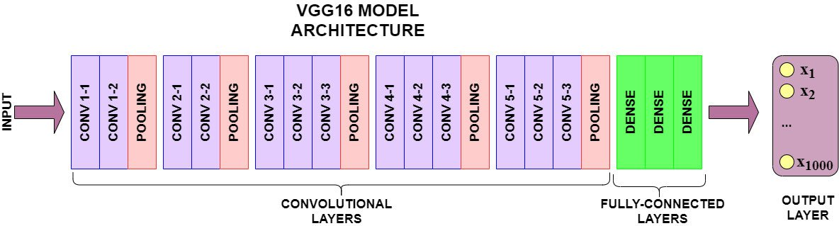
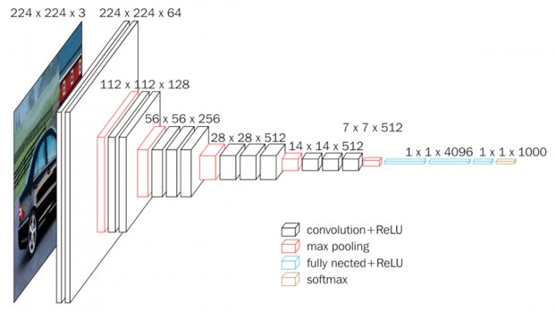
What is VGG16
‘VGG’ is the abbreviation for Visual Geometry Group, which is a group of researchers at the University of Oxford who developed this architecture, and ‘16’ implies that this architecture has 16 layers

Slide 8
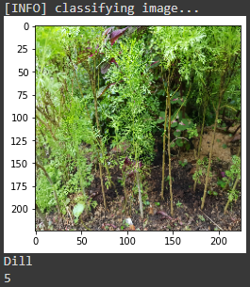
How is VGG16 used in the demo?
Simple Multi-Label Image Classification
Capable of classifying images with a class/label.
(Note: Typically you would only want the highest probability for Image Classification, therefore there is only 1 label displayed in our demo.)

Slide 9
Benefits & Limitations of VGG16
Benefits | Limitations
Easy to implement and train | Not suited for multiple object detection.
Many pre-trained weights on the internet | May take a long time for training.
Weights trained on VGG16 can be used for deeper model (e.g VGG19)

Slide 10
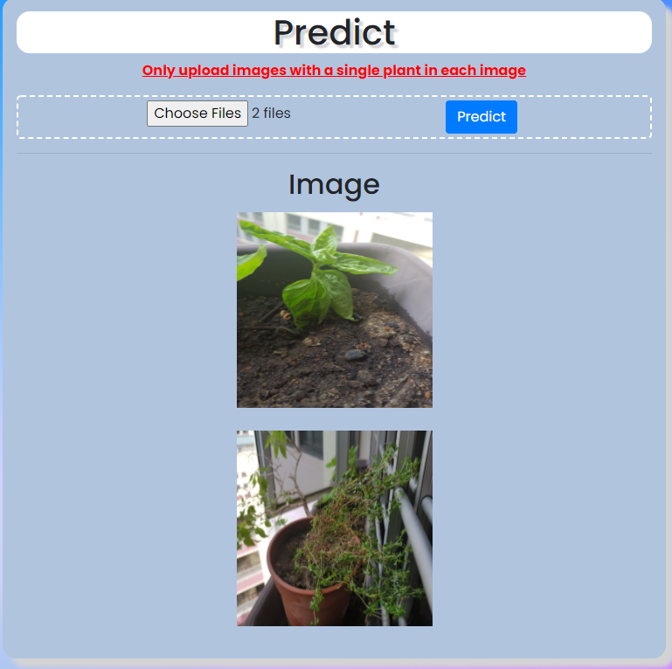
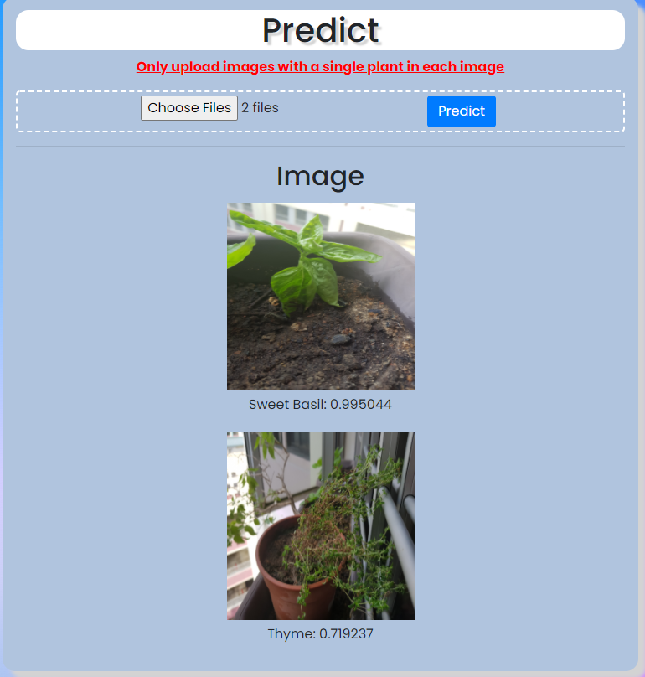
Example of VGG16 in a Web Application
Before pressing "Predict"
User is able to upload plant images upon clicking the "Choose Files" button.
Upon upload, the images are displayed without a label.
After pressing the "Predict" button, a label would be displayed below the images, indicating the type of plant that was predicted.
After pressing "Predict"

Slide 11
03
Demo Preparations

Slide 12
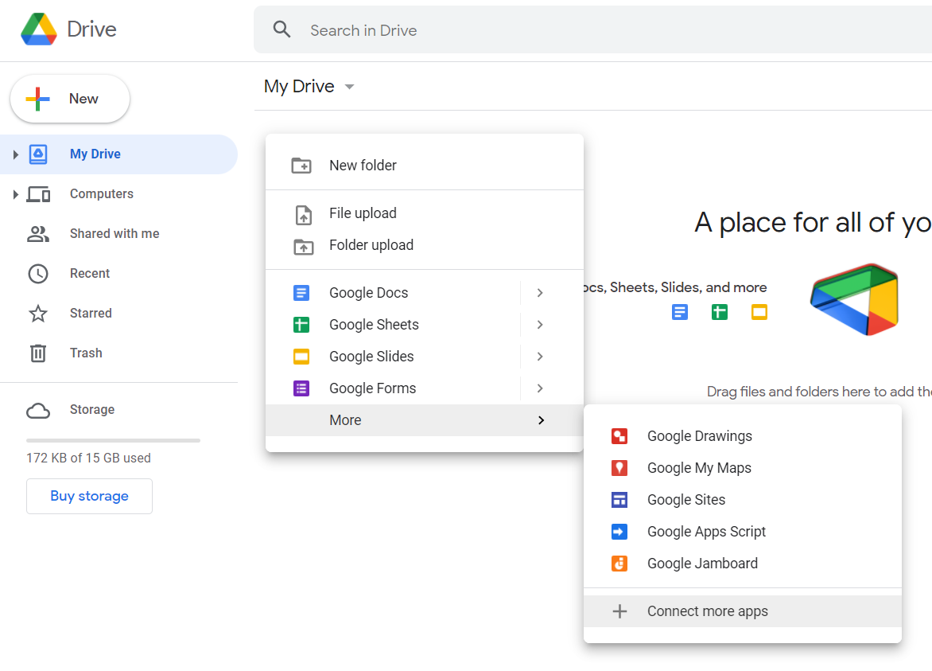
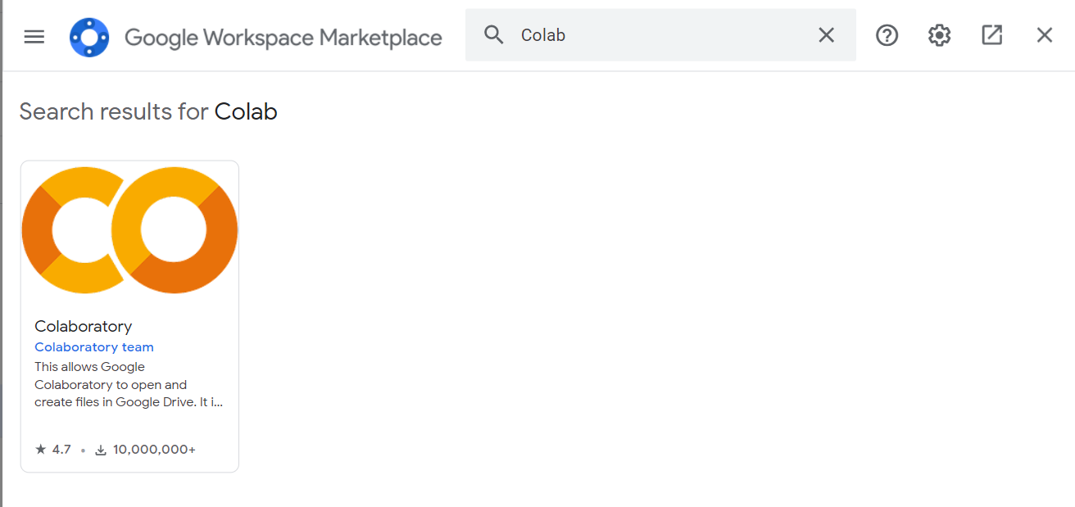
Steps to setup Google Colab
Ensure you are logged into your Google Account.
Access your Google Drive
Right click on the "My Drive" page, hover over "More", and select "Connect more apps"
Search for "Colab" in the popup window and install.

Slide 13

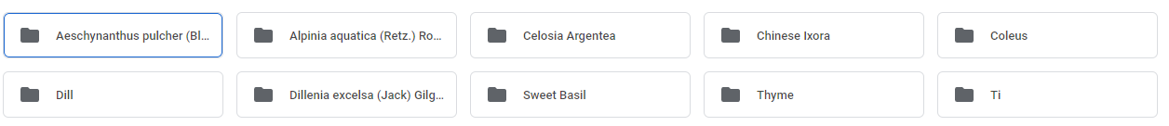
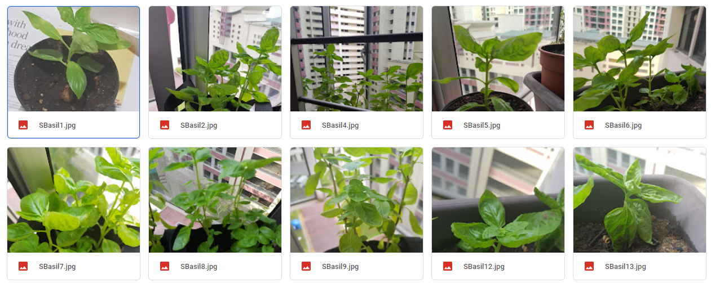
Steps to prepare images for the demo
Download the "TFScale VGG16 Demo" zip file from GitHub
Drag and drop the folder into the Google Drive
Create folder for each plant under the "data" folder
Place the plant images into the individual folders
Github link:
https://github.com/mager101/TFScale-VGG16-Demo

Slide 14
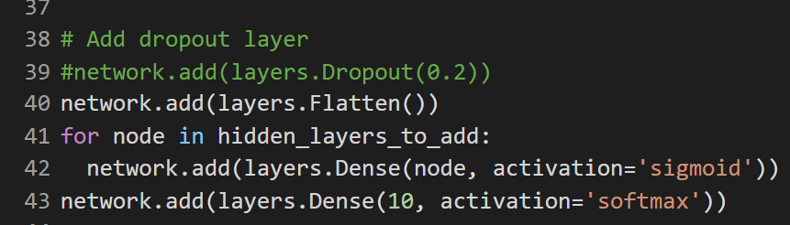
Things to Note
The model included in the ZIP folder is trained to classify 10 plants. If the "data" folder contains less/more than 10 plant folders, a ValueError would be displayed.
To solve this issue, modify line 43 of the "Prepare the model (using Transfer Learning" section to be the number of folders that are found within the "data" folder. Then run the following sections of code. (Retrain model, could also be done if wanting to improve accuracy of model)
The folders and images found within the "data" folder serve as only examples and can be deleted if necessary. (Images used for included model)
Image Annotation is not necessary for the demo.
If you are confused about anything, please do not hesitate to ask us.
Error that would be shown if there are 9 folders in "data"
To solve the above error, modify line 43 from 10 to 9

Slide 15
Hands-on Demo

Slide 16
Thanks!
Do you have any questions?

Slide 17
Resources
https://medium.com/@mygreatlearning/what-is-vgg16-introduction-to-vgg16-f2d63849f615

